Slide 1

Apache Hadoop:
Using Apache Hadoop to build
Enterprise Data Lake
Presented by
Mohammed Sarshaar

Slide 2
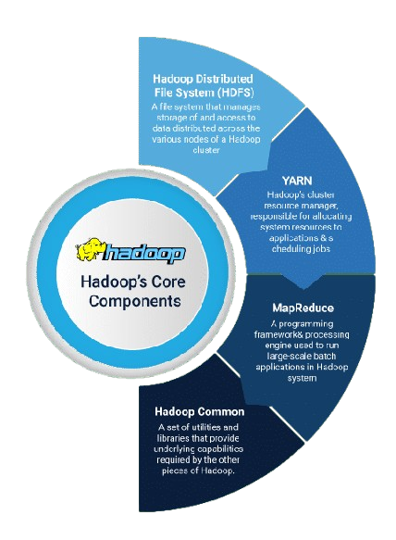
The Hadoop Ecosystem
Hadoop is an open-source software framework that allows for the distributed processing of large datasets across clusters of computers.
ffHDFS
YARN:
Yet Another Resource Negotiator (YARN) resource management system manages cluster's resources.
HDFS:
HDFS is a distributed file system that stores data across multiple nodes in a cluster.
MapReduce:
MapReduce is a programming model that allows for parallel processing of data.
Hive:
Hive provides a SQL-like interface for querying data stored in HDFS.

Slide 3
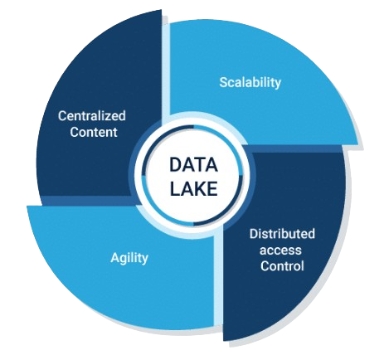
Enterprise Data Lake
An enterprise data lake is a centralized repository for storing all of an organization's data, both structured and unstructured.
It provides a single source of truth for data across the enterprise and enables organizations to gain insights from all of their data, regardless of its source.
ffHDFS
Unified Data Access:
Provides a single source of truth for all data across the enterprise.
Data Discovery:
Enables organizations to discover new insights and patterns in their data.
Improved Analytics:
Supports a wide range of data analysis and machine learning tasks.
Increased Agility:
Allows organizations to respond quickly to changing business needs.

Slide 4
Industry Overview and Business Problem
Organizations collect and analyze large amounts of data from disparate data sources using Enterprise Data Warehouses and Analytics Tools making it difficult to manage storage, processing, and analytics at scale.
Data Marts in the traditional Enterprise Data Warehouses are designed individually that doesn’t allow organizations to perform comprehensive and efficient analytics.
Business Problem and Challenges:
Data Silos
Manual Analysis
Limited Insights
Data is scattered across different systems, making it difficult to gain a holistic view of the customer.
Traditional methods rely on manual data processing, which is time-consuming and prone to error.
Traditional methods often fail to uncover hidden patterns and trends in the data.

Slide 5
Implementing Hadoop Solution
Big data solutions like Apache Hadoop can easily scale to handle increasing amounts of data, allowing organizations to process and analyze massive datasets without performance degradation.
These technologies enable distributed computing, where data is processed across multiple servers or nodes. This parallel processing speeds up data analysis and reduces the time required for insights.
Data Integration and Management
Extracting data from multiple sources.
Data Cleansing and Transformations
Data Cleansing
Big Data Analysis
Performing Data Science and ML activities to derive insights.
Data Storage into suitable data sources
Using Visualization tools for reporting
Implementing data transformations as per business logic.

Slide 6
Data Analytics using Hadoop
Data is ingested into cloud from multiple data sources like File System, SQL Database, Snowflake, AWS RDS
Data Analytics is performed using Big Data frameworks like Apache Hadoop, Spark, Hive etc
It allows storage of real time streaming data from mobile apps, IoT devices and social media.
ML helps in deriving valuable insights used for business reporting and provide possible outcomes and suggestions
BI tools such as Power BI and Tableau are used to build dashboards and reports
Data Sources
Data Storage
Data Analytics
Machine Learning
Visualization

Slide 7
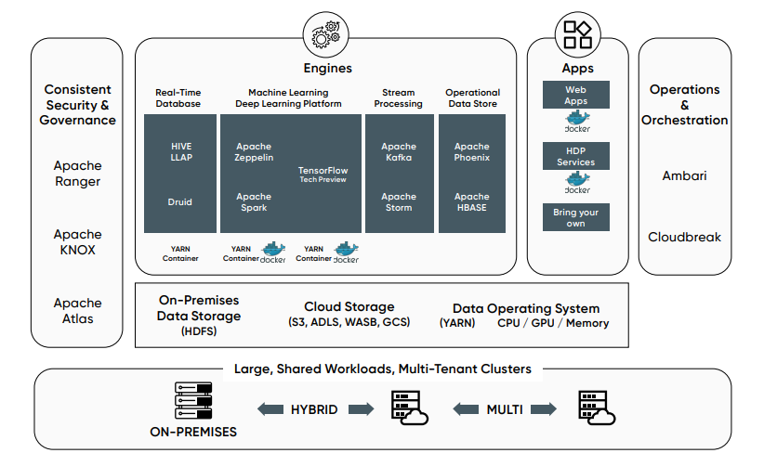
Technical Architecture Diagram

Slide 8
Data Collection and Ingestion
1. Data Ingestion:
Ingest data from diverse sources, such as databases, log files, and real-time streams, using tools like Flume, Kafka, and Sqoop
2. Data Preprocessing:
Perform data cleansing, transformation, and enrichment to ensure data quality and consistency before storing in the data lake.
3. Batch and Real-Time Ingestion:
Support both batch and real-time data ingestion to cater to a wide range of analytical requirements.

Slide 9
Data Storage and Management
1. HDFS Storage:
Utilize the Hadoop Distributed File System (HDFS) to store and manage data in a highly scalable and fault-tolerant manner.
2. Metadata Management:
Leverage metadata cataloging tools like Apache Hive to provide a comprehensive view of the data assets in the data lake.
3. Data Exploration and Analysis
Empower users to explore and analyze data using SQL-based tools like Apache Hive and Apache Impala.

Slide 10
Data Processing and Transformation
1. Batch Processing:
Utilize Hadoop MapReduce and Apache Spark for large-scale batch data processing and transformation.
2. Real-Time Processing:
Leverage stream processing frameworks like Apache Spark Streaming or Apache Flink for low-latency, real-time data processing.
3. Data Exploration and Analysis:
Empower users to explore and analyze data using SQL-based tools like Apache Hive and Apache Impala.

Slide 11




Scalability and Performance Optimization
Storage Scaling
Computing Power
Seamlessly scale storage capacity by adding more commodity hardware to the Hadoop cluster.
Increase computing power by adding more nodes to the cluster, enabling parallel data processing.
Performance Tuning
Monitoring and Alerting
Optimize data lake performance through techniques like data partitioning, indexing, and caching.
Implement robust monitoring and alerting mechanisms to ensure the data lake operates at peak efficiency.

Slide 12
Conclusion
Hadoop enables organizations to build a flexible, scalable, and cost-efficient Data Lake capable of handling large-scale data and supporting advanced analytics.
Through its components (HDFS, YARN, MapReduce, and others), it ensures that enterprises can handle diverse data sources, process large datasets efficiently, and maintain data governance and security.
In today’s data-driven world, Apache Hadoop plays a crucial role in helping organizations turn raw data into actionable insights, powering the next generation of enterprise decision-making.

